Slide 1
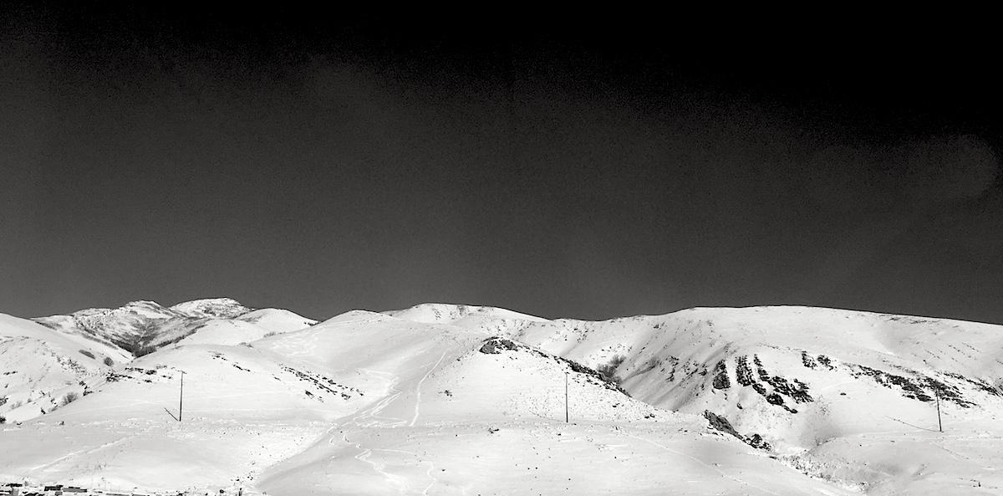
VCF annotation and interpretation
Applied Computational Genomics, Lecture 12
https://github.com/quinlan-lab/applied-computational-genomics
Aaron Quinlan
Departments of Human Genetics and Biomedical Informatics
USTAR Center for Genetic Discovery
University of Utah
quinlanlab.org

Slide 2
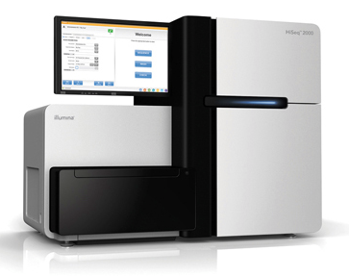
Variant Calling Overview
FASTQ
Align
(BWA)
BAM
Detect SNP/INDELs
(GATK or FreeBayes)
VCF

Slide 3
Raw VCF files are naked. Interpretation requires annotation.
##fileformat=VCFv4.3
##fileDate=20090805
##source=variantcallerXYZ
##reference=file:///seq/references/1000GenomesPilot-NCBI36.fasta
##contig=<ID=20,length=62435964,assembly=B36,md5=379d618ff66beb2da,species="Homo sapiens",taxonomy=x>
##phasing=partial
##INFO=<ID=NS,Number=1,Type=Integer,Description="Number of Samples With Data">
##INFO=<ID=DP,Number=1,Type=Integer,Description="Total Depth">
##INFO=<ID=AF,Number=A,Type=Float,Description="Allele Frequency">
##INFO=<ID=AA,Number=1,Type=String,Description="Ancestral Allele">
##INFO=<ID=DB,Number=0,Type=Flag,Description="dbSNP membership, build 129">
##INFO=<ID=H2,Number=0,Type=Flag,Description="HapMap2 membership">
##FILTER=<ID=q10,Description="Quality below 10">
##FILTER=<ID=s50,Description="Less than 50% of samples have data">
##FORMAT=<ID=GT,Number=1,Type=String,Description="Genotype">
##FORMAT=<ID=GQ,Number=1,Type=Integer,Description="Genotype Quality">
##FORMAT=<ID=DP,Number=1,Type=Integer,Description="Read Depth">
##FORMAT=<ID=HQ,Number=2,Type=Integer,Description="Haplotype Quality">
#CHROM POS ID REF ALT QUAL FILTER INFO FORMAT MOM DAD KID
20 14370 rs6054257 G A 29 PASS NS=3;DP=14; GT:GQ:DP:HQ 0|0:48:1:51,51 1|0:48:8:51,51 1/1:43:5:.,.
20 17330 . T A 3 q10 NS=3;DP=11; GT:GQ:DP:HQ 0|0:49:3:58,50 0|1:3:5:65,3 0/0:41:3
20 1110696 rs6040355 A G,T 67 PASS NS=2;DP=10; GT:GQ:DP:HQ 1|2:21:6:23,27 2|1:2:0:18,2 2/2:35:4
20 1234567 microsat1 GTC G,GTCT 50 PASS NS=3;DP=9; GT:GQ:DP 0/1:35:4 0/2:17:2 1/1:40:3
A/A
A/G
A/G
INFO, yes. But not so INFOrmative.

Slide 4

Raw VCF files are naked. Interpretation requires annotation.
##fileformat=VCFv4.3
##fileDate=20090805
##source=variantcallerXYZ
##reference=file:///seq/references/1000GenomesPilot-NCBI36.fasta
##contig=<ID=20,length=62435964,assembly=B36,md5=379d618ff66beb2da,species="Homo sapiens",taxonomy=x>
##phasing=partial
##INFO=<ID=NS,Number=1,Type=Integer,Description="Number of Samples With Data">
##INFO=<ID=DP,Number=1,Type=Integer,Description="Total Depth">
##INFO=<ID=AF,Number=A,Type=Float,Description="Allele Frequency">
##INFO=<ID=AA,Number=1,Type=String,Description="Ancestral Allele">
##INFO=<ID=DB,Number=0,Type=Flag,Description="dbSNP membership, build 129">
##INFO=<ID=H2,Number=0,Type=Flag,Description="HapMap2 membership">
##FILTER=<ID=q10,Description="Quality below 10">
##FILTER=<ID=s50,Description="Less than 50% of samples have data">
##FORMAT=<ID=GT,Number=1,Type=String,Description="Genotype">
##FORMAT=<ID=GQ,Number=1,Type=Integer,Description="Genotype Quality">
##FORMAT=<ID=DP,Number=1,Type=Integer,Description="Read Depth">
##FORMAT=<ID=HQ,Number=2,Type=Integer,Description="Haplotype Quality">
#CHROM POS ID REF ALT QUAL FILTER INFO FORMAT MOM DAD KID
20 14370 rs6054257 G A 29 PASS NS=3;DP=14;GENE=ABC GT:GQ:DP:HQ 0|0:48:1:51,51 1|0:48:8:51,51 1/1:43:5:.,.
20 17330 . T A 3 q10 NS=3;DP=11;GENE=DDD GT:GQ:DP:HQ 0|0:49:3:58,50 0|1:3:5:65,3 0/0:41:3
20 1110696 rs6040355 A G,T 67 PASS NS=2;DP=10;GENE=TTN GT:GQ:DP:HQ 1|2:21:6:23,27 2|1:2:0:18,2 2/2:35:4
20 1234567 microsat1 GTC G,GTCT 50 PASS NS=3;DP=9;GENE=XYZ GT:GQ:DP 0/1:35:4 0/2:17:2 1/1:40:3
A/A
A/G
A/G

Slide 5
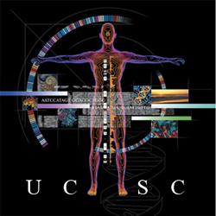
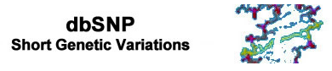








Annotation provides context for interpretation.
Conservation
Repeat elements
Genome Gaps
Cytobands
Gene annotations
“Mappability”
DeCIPHER
ISGA
Genetic variation
...CCTCATGCATGGAAA...
...CCTCATGTATGGAAA...
...CCTCATGCATGGAAA...
...CCTCATGCATGGAAA...
...CCTCATGTATGGAAA...
...CCTCATGCATGGAAA...
...CCTCATGTATGGAAA...
Chromatin marks
DNA methylation
RNA expression
TF binding

Slide 6
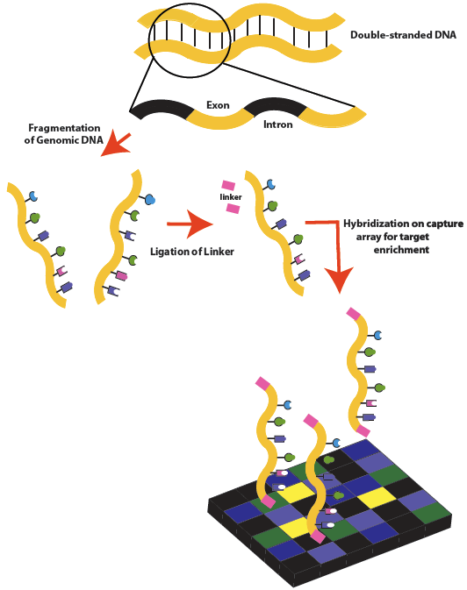
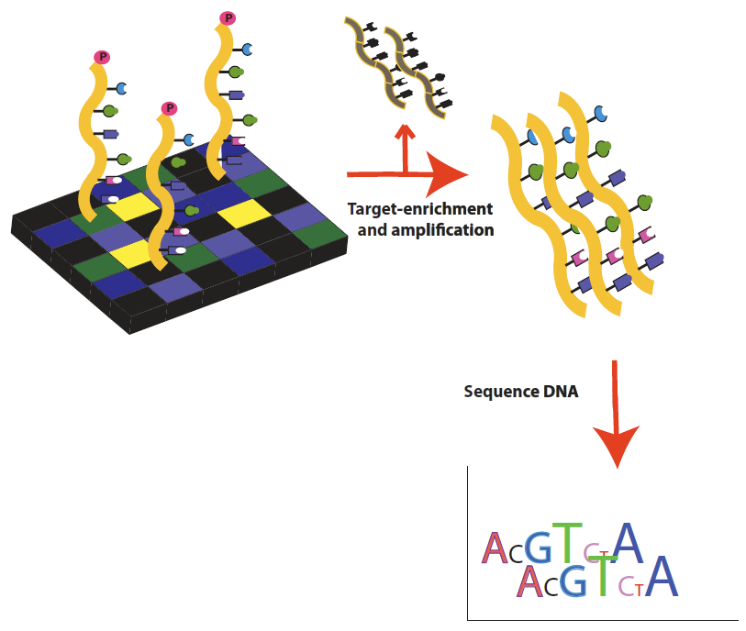
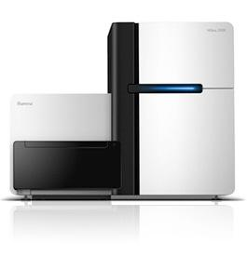
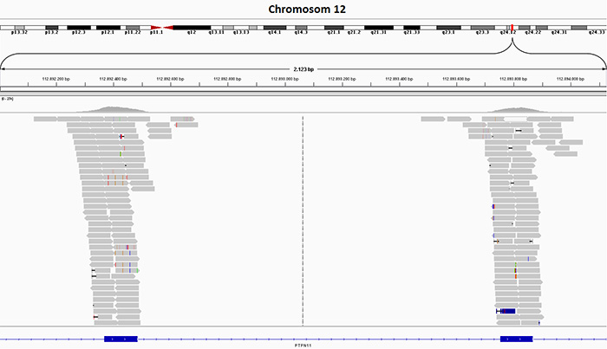
Case study: exome sequencing for rare disease
Mom and dad are unaffected, kid (proband) is affected with rare, Mendelian disease phenotype
exon
intron
exon

Slide 7
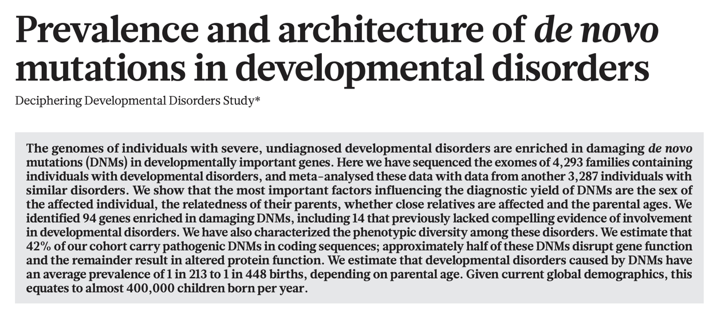
>40% of developmental disorders caused by de novo mutation
https://www.nature.com/articles/nature21062.pdf

Slide 8

Goal: find variants that disrupt gene function
Impact sometimes hard to predict.
synonymous (silent)
non-synonymous (missense)
L
Q
T
L
Q
T
Normal
ctg cag act
Normal
ctg cag act
Mutated
ctg caa act
Mutated
ctg cgg act
L
Q
T
L
R
T
stop-gain (nonsense)
stop-loss
L
Q
T
L
T
Normal
ctg cag act
Normal
ctg tag act
Mutated
ctg tag act
Mutated
ctg cag act
L
T
L
Q
T

Slide 9
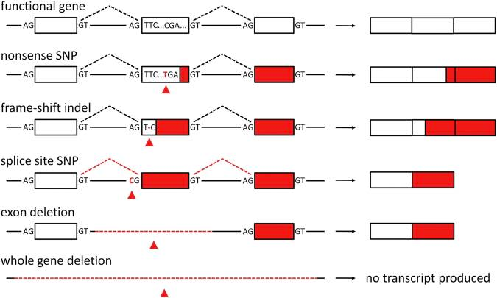
Loss of function variants
MacArthur et al, Science. 2012 February 17; 335(6070): 823–828.

Slide 10
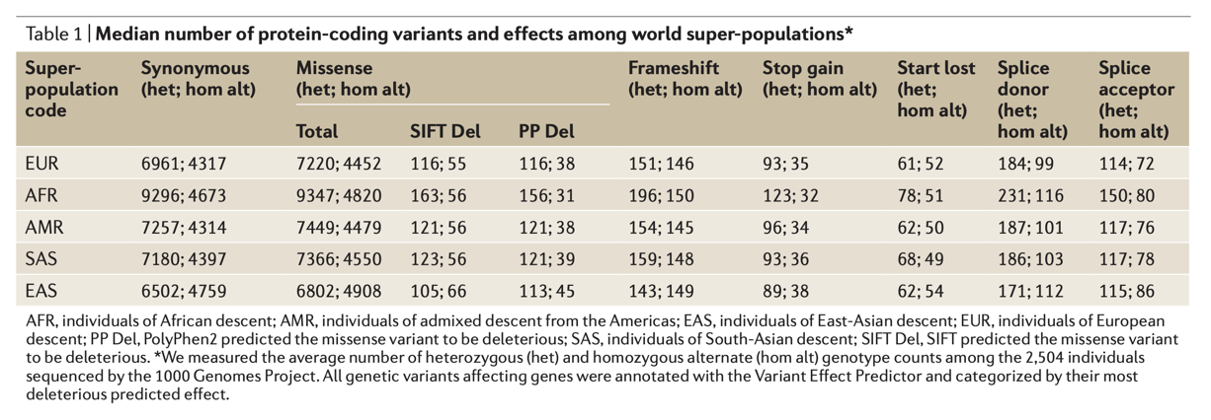
Uh oh. Needle in a haystack problem.
https://www.nature.com/articles/nrg.2017.52.pdf
Many predicted loss of function variants observed in a typical human. Even as a homozygote!!!

Slide 11
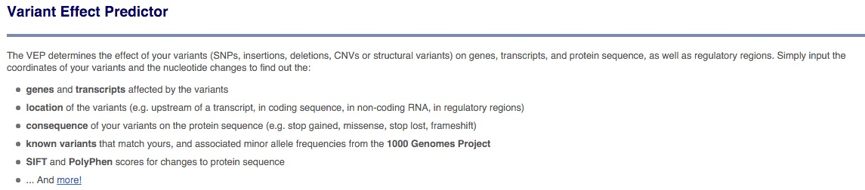
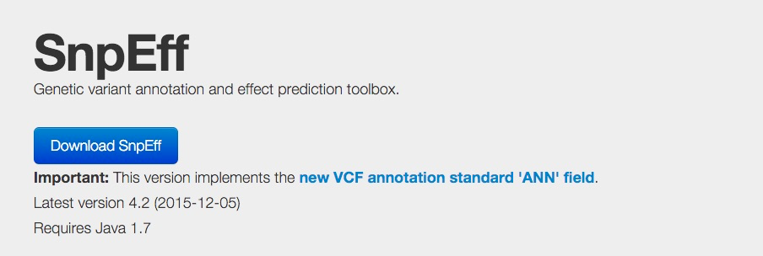
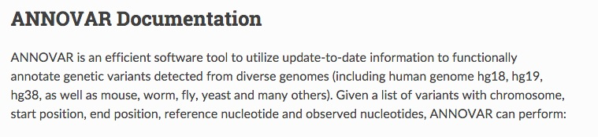
Annotating the "effect" of a variant on a transcript

Slide 12
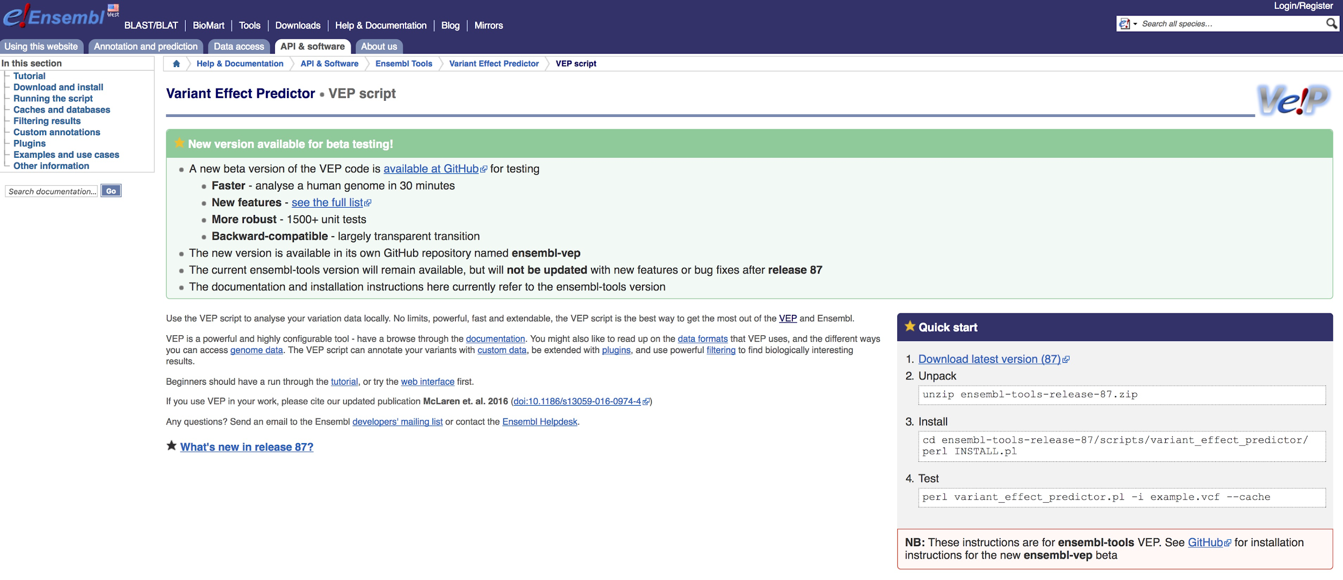
Variant Effect Predictor (VEP)
http://uswest.ensembl.org/info/docs/tools/vep/script/index.html

Slide 13





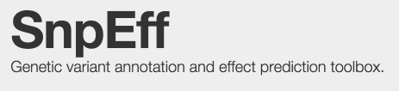


Many tools + many transcript annotations = many answers
Transcripts
Tools
VAT (Yandell; part of VAAST)

Slide 14
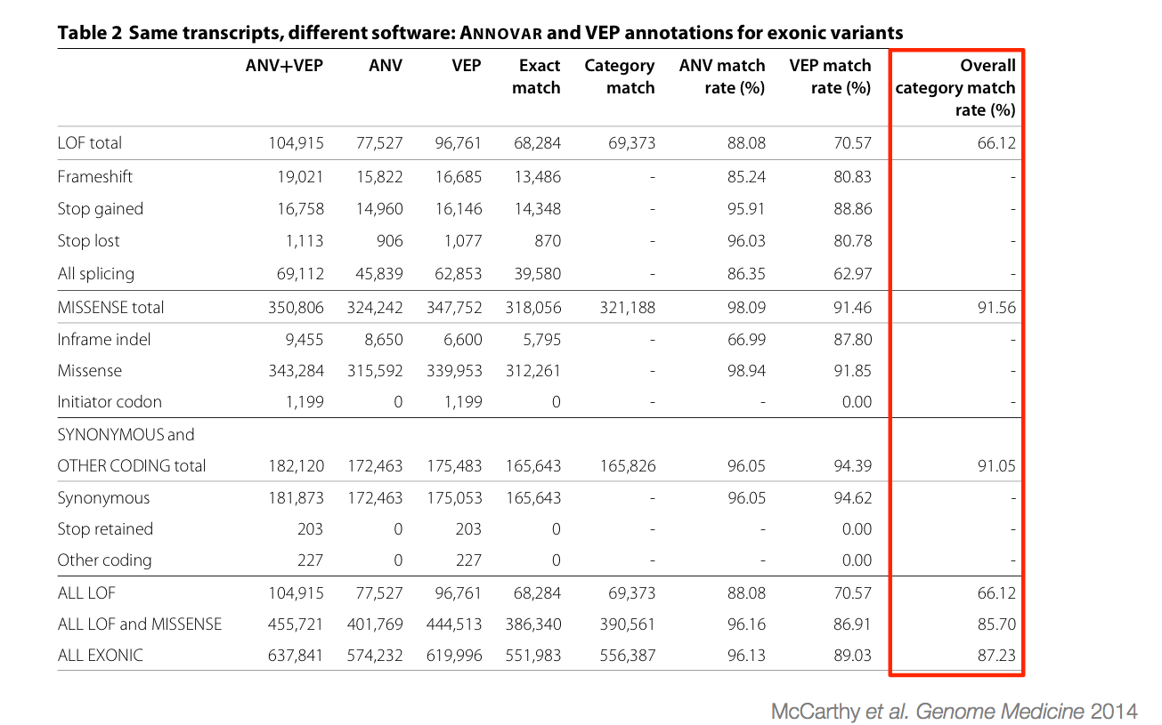
Many tools + many transcript annotations = many answers

Slide 15
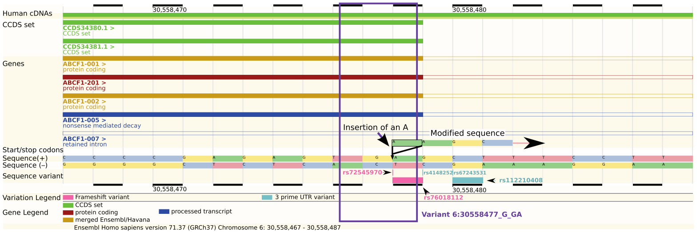
An example of the complexity
Insertion of a single A. What is the impact?
frameshift
stopgain
synonymous
yes

Slide 16
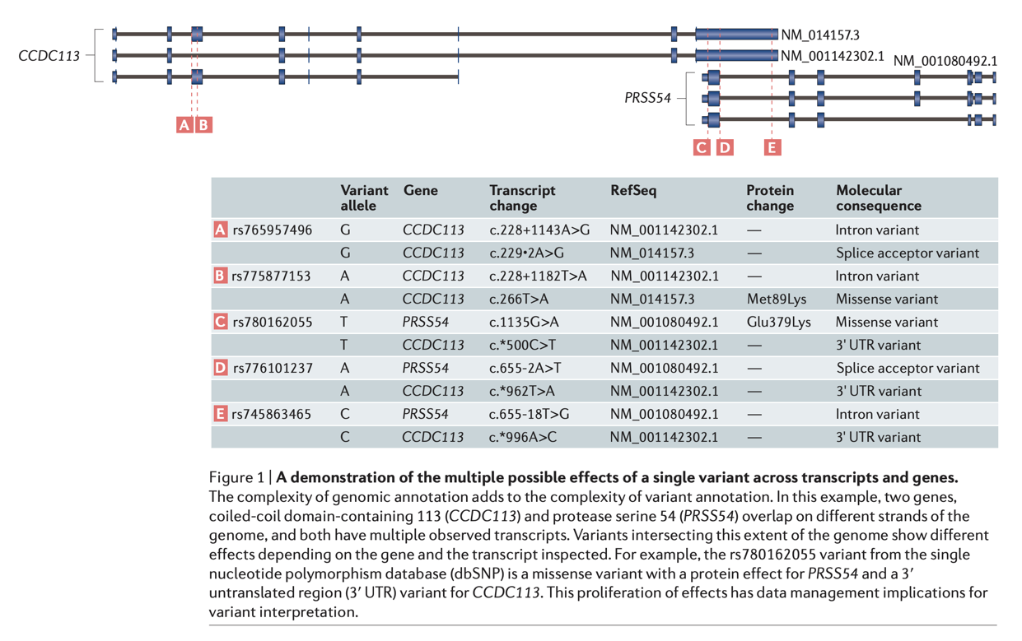
Variants overlap multiple transcripts and even genes
https://www.nature.com/articles/nrg.2017.52.pdf

Slide 17
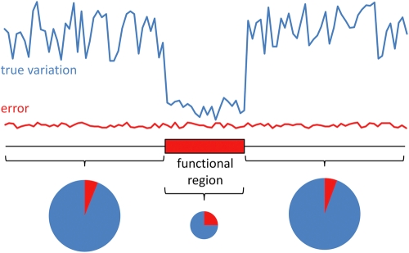
Apparent loss-of-function variants are enriched for error.

Slide 18
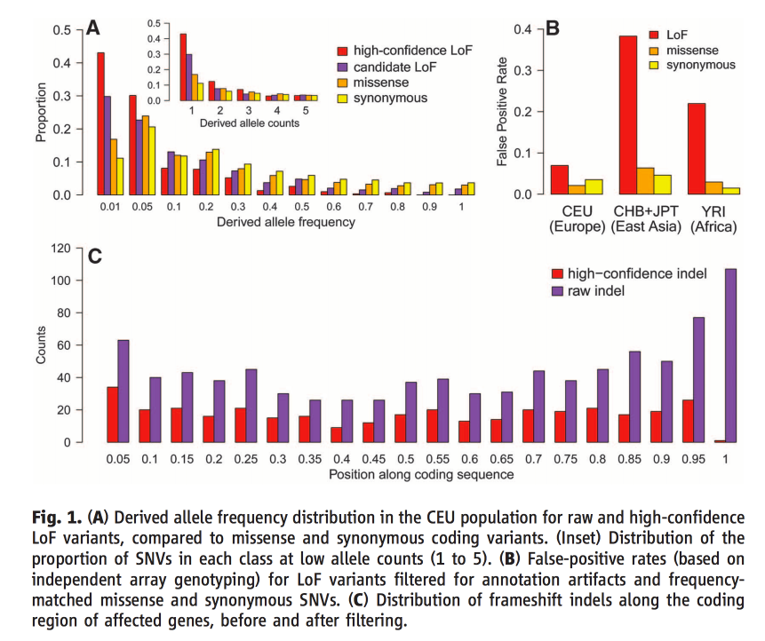
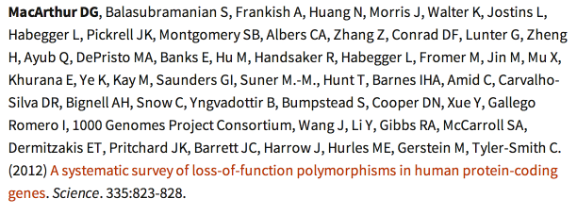
Apparent loss-of-function variants are fraught with error.

Slide 19
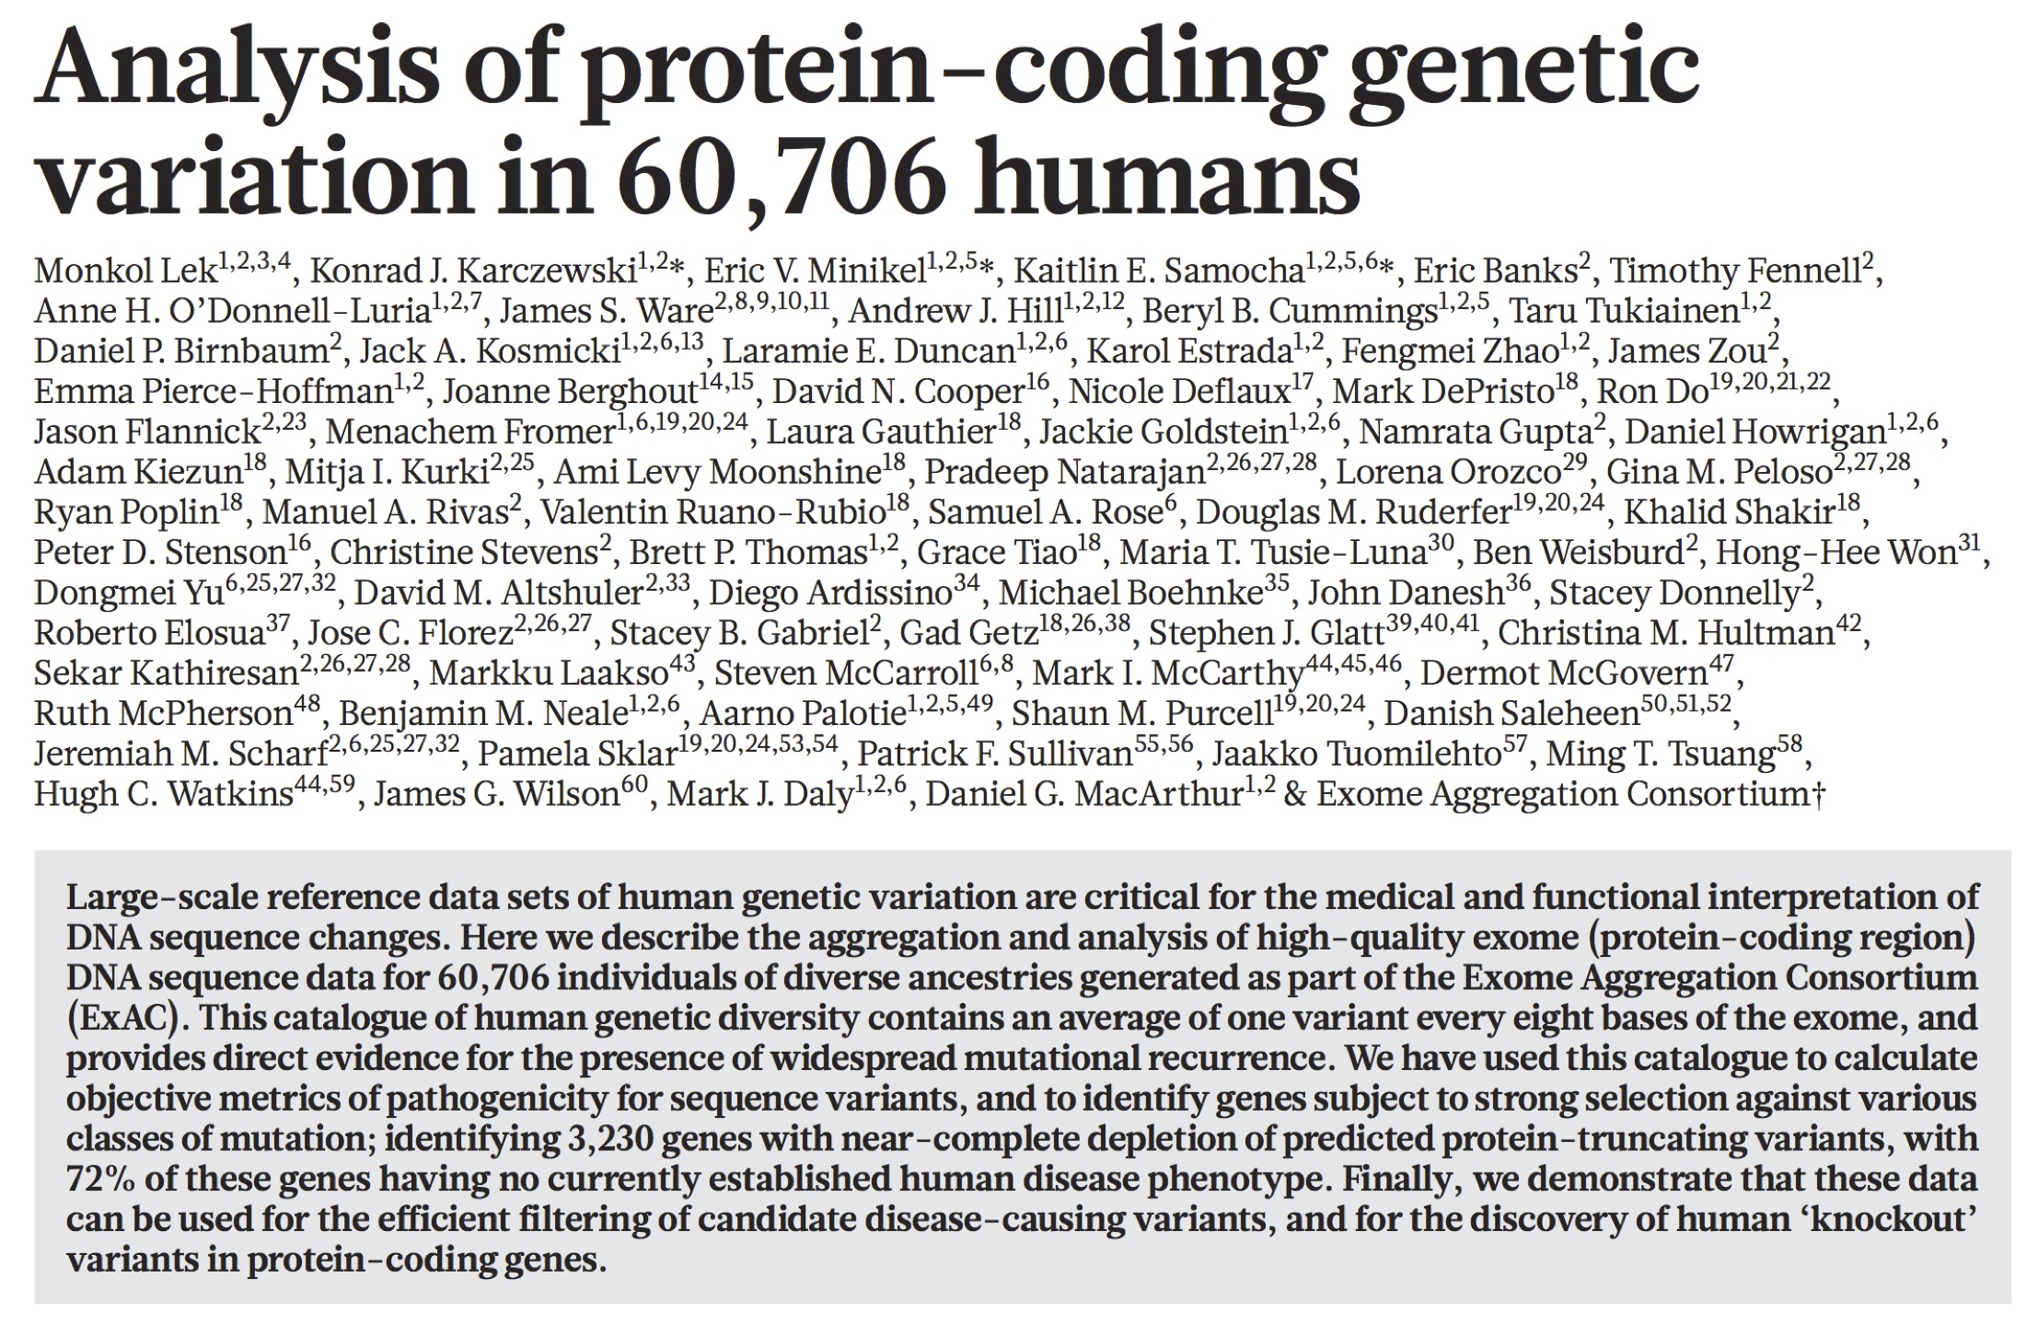
If a disease phenotype is rare, the causal variant should also be similarly rare

Slide 20
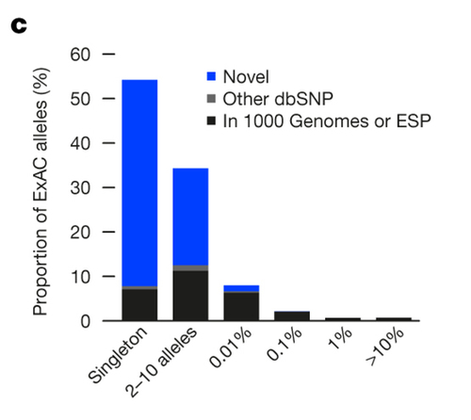
If a disease phenotype is rare, the causal variant should also be similarly rare
>50% of the 9 million variants discovered were present as a heterozygote in 1 out of the 60706 individuals (a "singleton"). >90% present on <=10 chromosomes sampled
http://www.nature.com/nature/journal/v536/n7616/pdf/nature19057.pdf

Slide 21
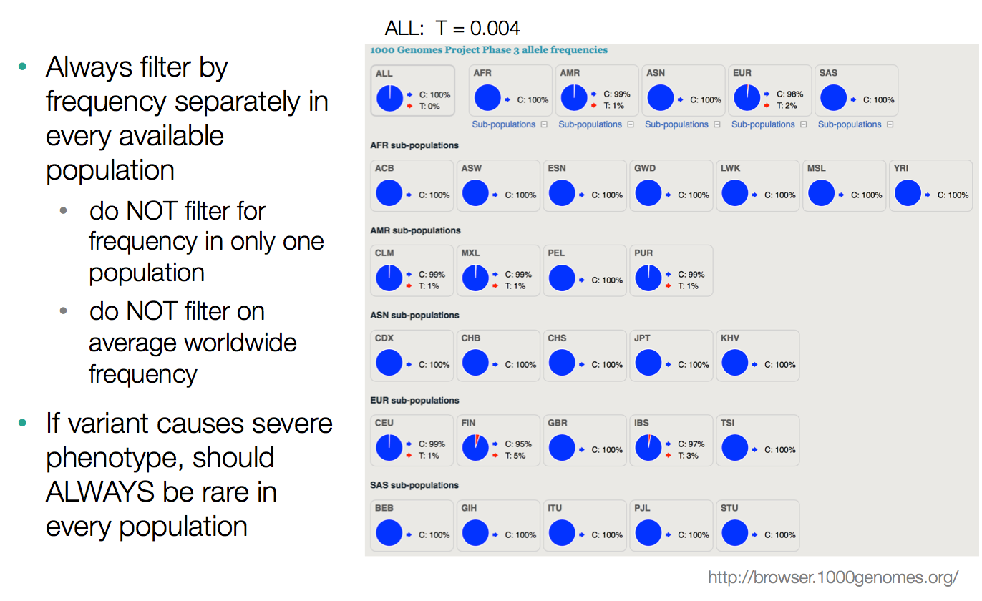
An allele underlying a rare disease should be rare in all ancestries!
Slide courtesy of Jessica Chong, University of Washington Center for Mendelian Genomics

Slide 22
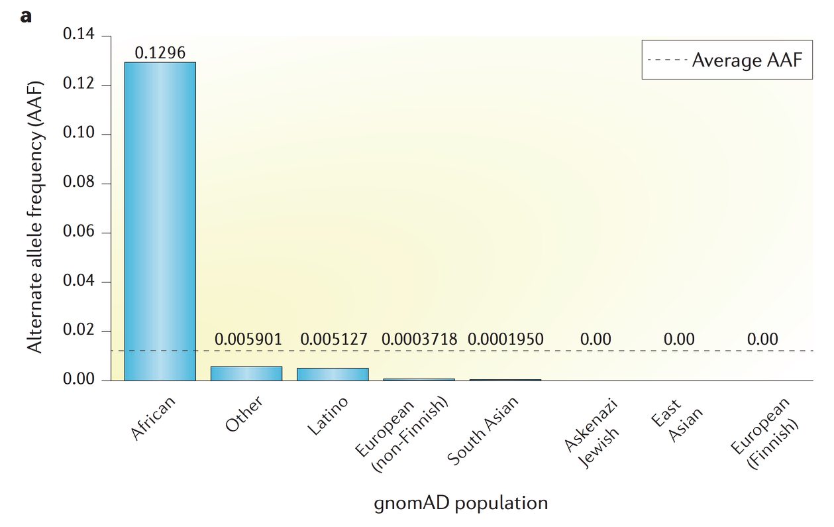
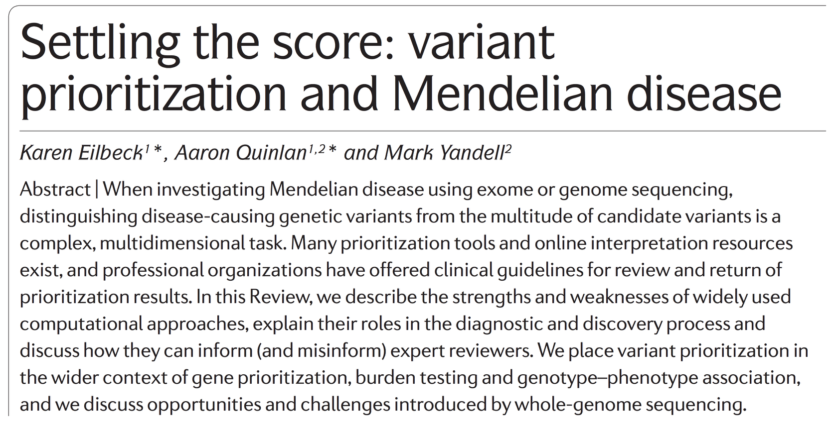
An allele underlying a rare disease should be rare in all ancestries!
Nature Reviews Genetics, 2017

Slide 23
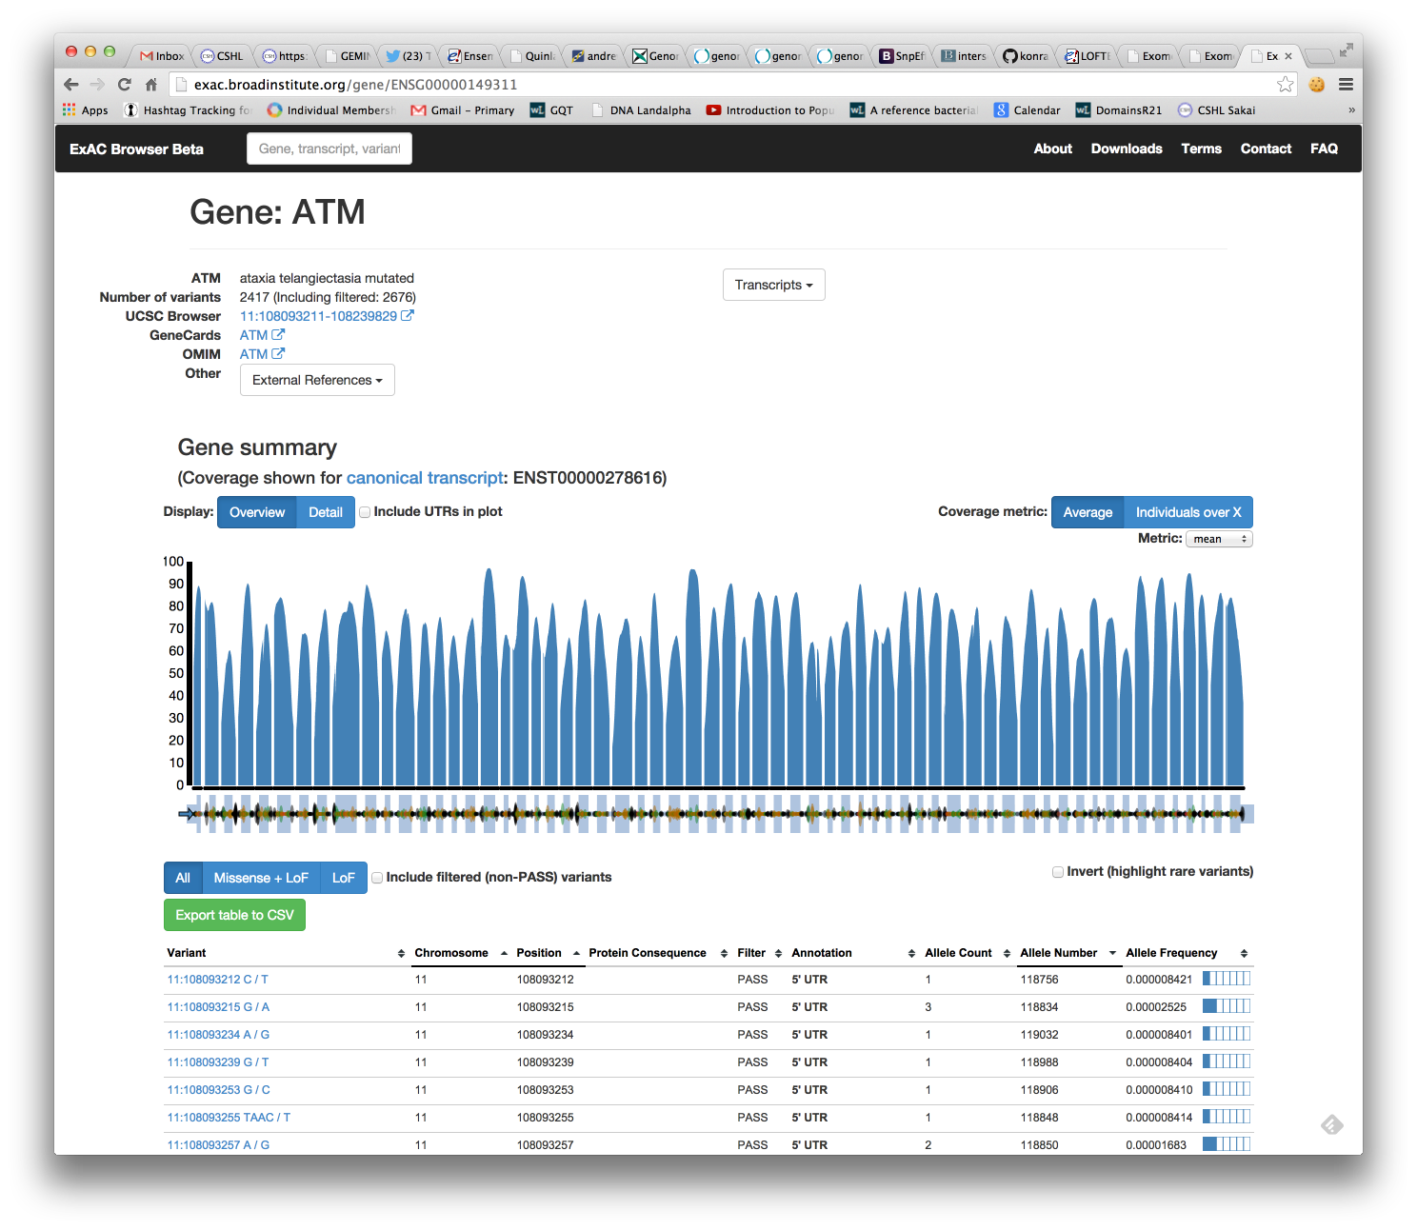
gnomAD reports the allele frequency from diverse ancestries
exac.broadinstitute.org
gnomad.broadinstitute.org

Slide 24
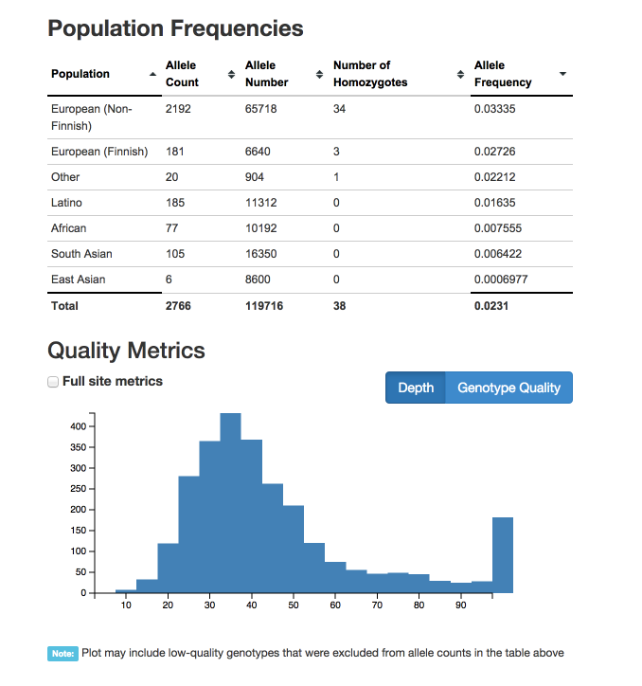
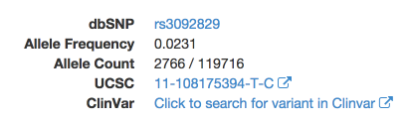
gnomAD reports the allele frequency from diverse ancestries

Slide 25
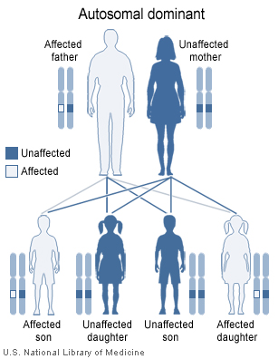
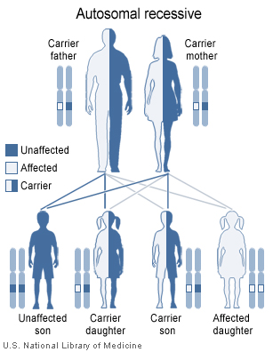
We can also prioritize variants based upon inheritance pattern
e.g., Huntington’s disease
e.g., cystic fibrosis

Slide 26
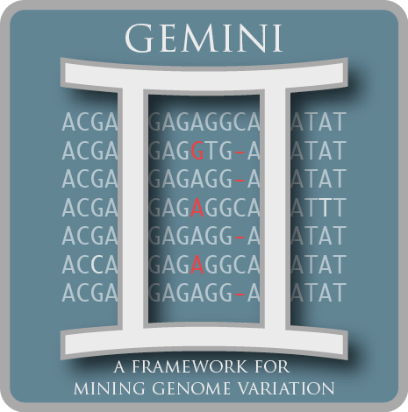
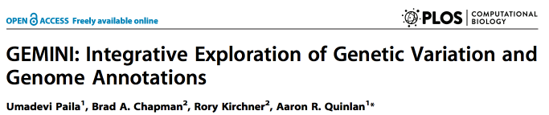
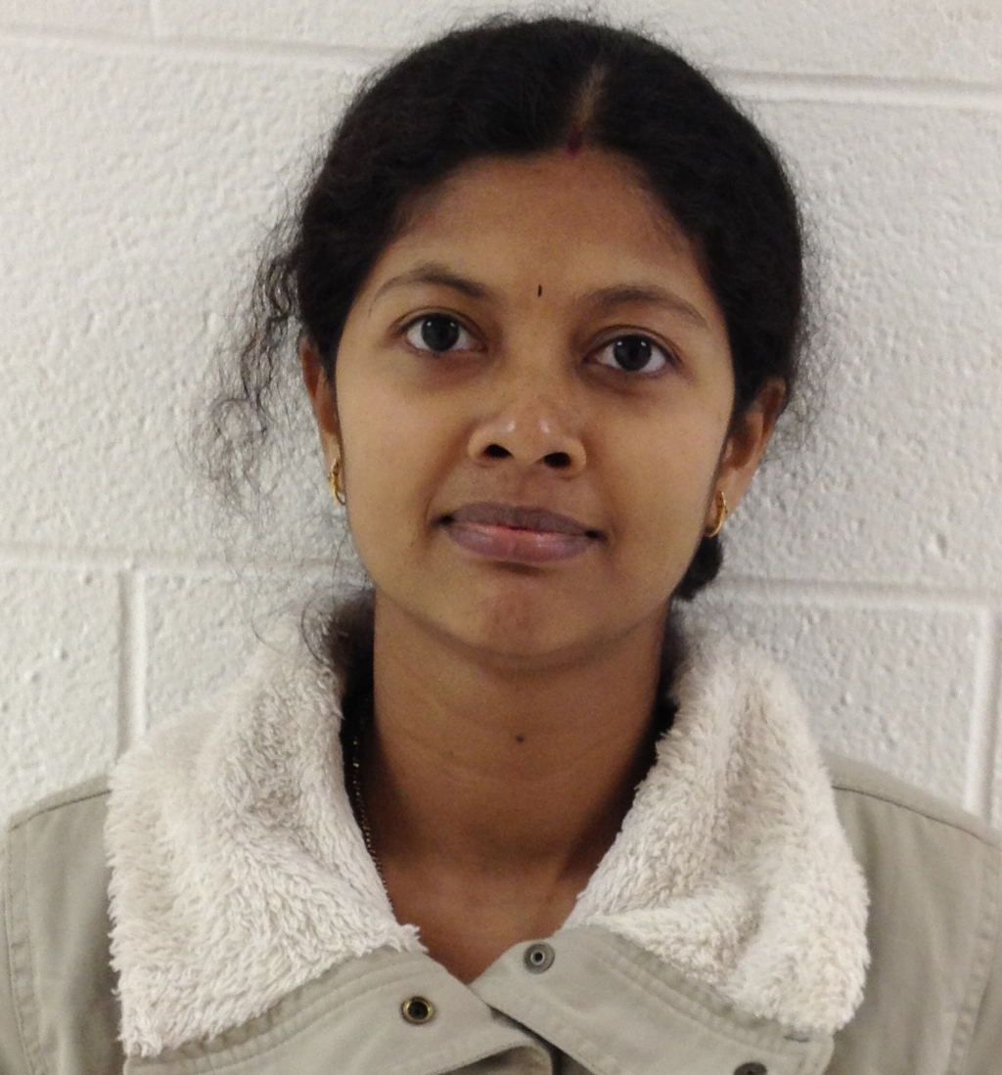

We can also prioritize variants based upon inheritance pattern
code: github.com/arq5x/gemini
docs: gemini.readthedocs.org
Uma
Paila
Brent
Pedersen

Slide 27
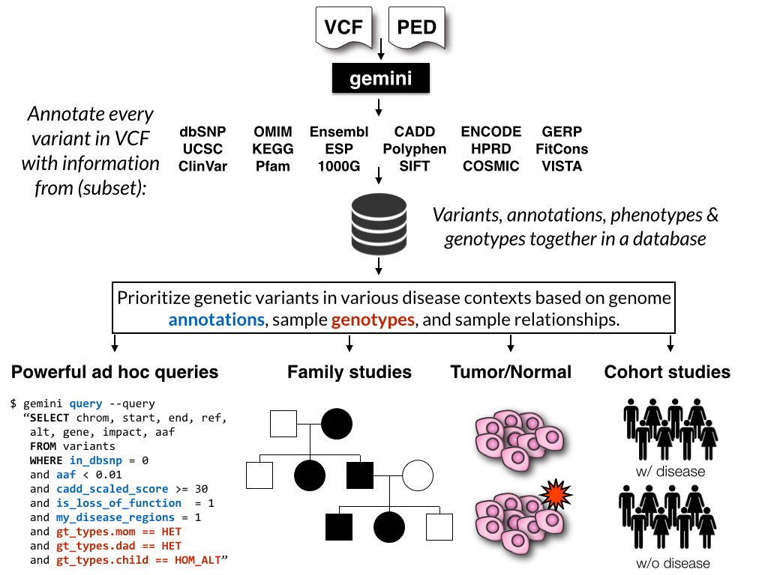
GEMINI: automated tools for disease inheritance models

Slide 28
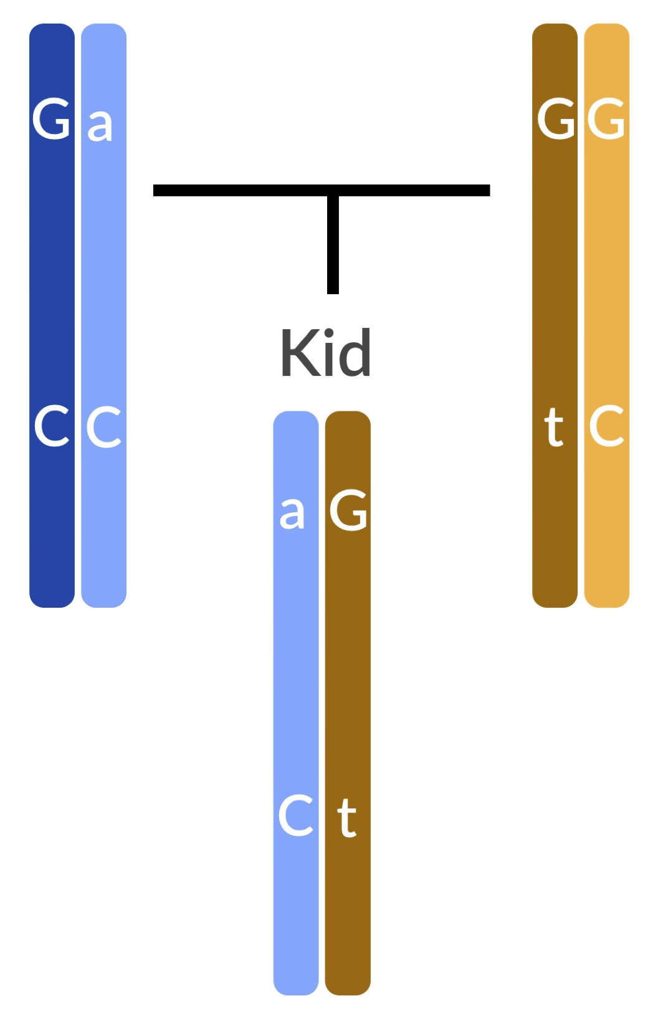
Example: finding compound heterozygotes in Mendelian diseases
Dad
Mom
Kid

Slide 29
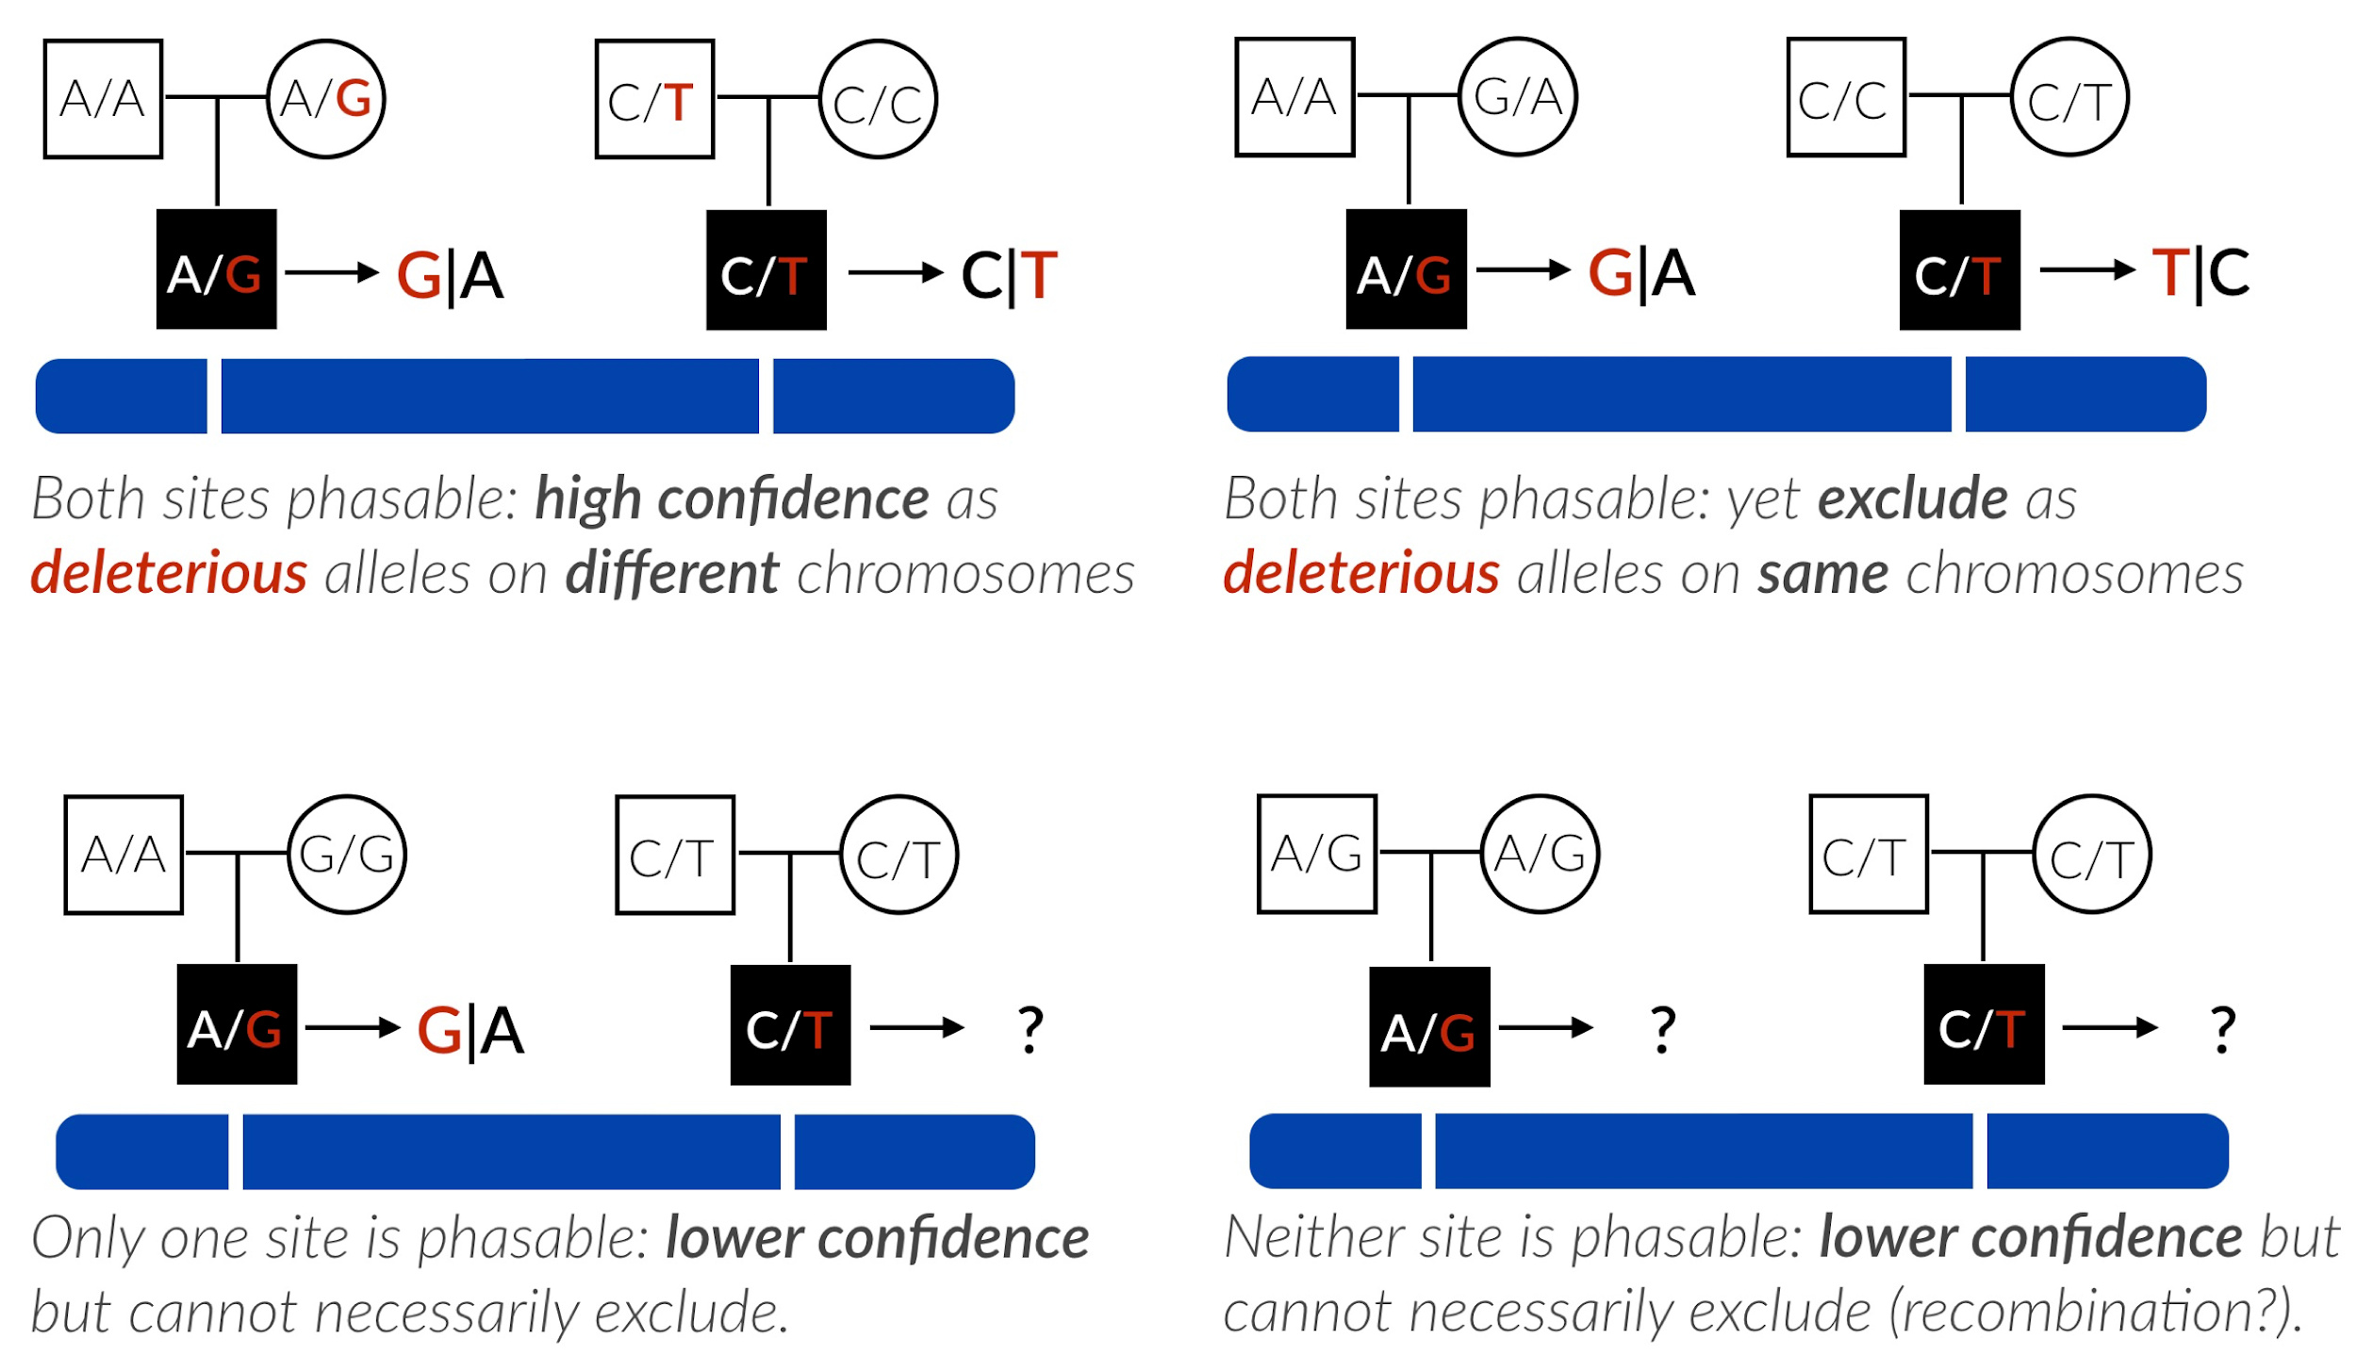
Phasing by transmission (inheritance) at informative sites

Slide 30
Example: finding compound heterozygotes in Mendelian diseases
$ gemini comp_hets
--columns "chrom, start, end,
gene, impact"
--min-kindreds 2
--max-priority 1
--filter "impact_severity != 'LOW'
and max_aaf_all < 0.001"
disease.db
Penetrant
Confident
(i.e. on diff. chroms
via familial phasing)
Deleterious
Rare in all ancestries
chr17 78081692 78081693 GAA non_syn_coding 4.33 14401 family1 1805;unaffected,1847;unaffected4805;affected T/T,T/C,T|C 4805 1 16_14401_14406 1
chr17 78084748 78084749 GAA non_syn_coding 5.51 14406 family1 1805;unaffected,1847;unaffected4805;affected G/A,G/G,A|G 4805 1 16_14401_14406 1
chr2 129025757 129025758 HS6ST1 non_syn_coding 2.67 3657 family1 1805;unaffected,1847;unaffected4805;affected C/A,C/C,A|C 4805 1 45_3657_3660 1
chr2 129075743 129075744 HS6ST1 non_syn_coding 3.25 3660 family1 1805;unaffected,1847;unaffected4805;affected G/G,G/C,G|C 4805 1 45_3657_3660 1
chr22 45255643 45255644 PRR5-ARHGAP8 non_syn_coding 1.88 16838 family1 1805;unaffected,1847;unaffected4805;affected G/G,G/T,G|T 4805 1 169_16838_16839 1
chr22 45255687 45255688 PRR5-ARHGAP8 non_syn_coding 0.37 16839 family1 1805;unaffected,1847;unaffected4805;affected C/T,C/C,T|C 4805 1 169_16838_16839 1
chr15 71548994 71548995 THSD4 non_syn_coding 3.68 8777 family1 1805;unaffected,1847;unaffected4805;affected C/C,C/T,C|T 4805 1 181_8777_8780 1
chr15 71952898 71952899 THSD4 non_syn_coding 4.52 8780 family1 1805;unaffected,1847;unaffected4805;affected G/A,G/G,A|G 4805 1 181_8777_8780 1

Slide 31
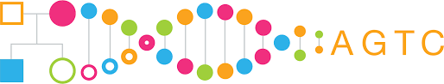

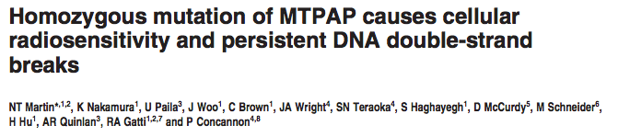
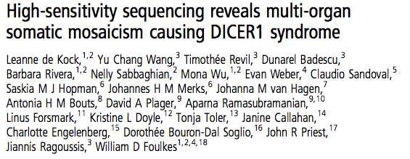
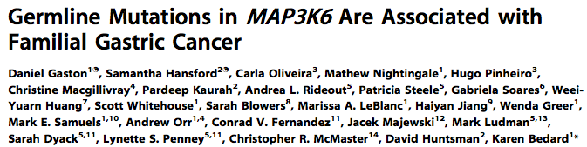
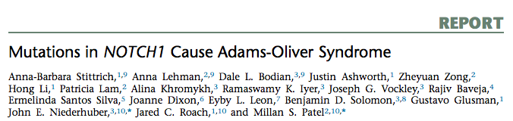
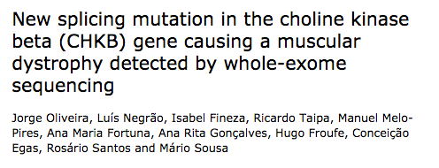
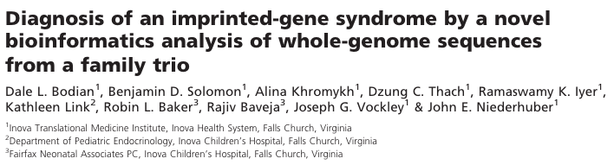
GEMINI is widely-used for rare disease research.
UW Center
for Mendelian Genomics

Slide 32






vcfanno will quickly and flexibly annotate your VCF.
Naked
VCF
VCF
w/ annotations
in INFO field
VCF, BED, GFF, BAM
Brent Pedersen
https://github.com/brentp/vcfanno
https://genomebiology.biomedcentral.com/articles/10.1186/s13059-016-0973-5

Slide 33

VCF before and after vcfanno.
Vcfanno configuration file
[[annotation]]
file=“ExAC.v3.vcf”
fields=[“AF”, “AC_Het”]
names=[“exac_aaf”, “exac_num_het”]
ops=[“first”, “first”]
[[annotation]]
file="dbsnp.b141.vcf.gz"
fields=["ID"]
names=["rs_ids"]
ops=[“concat"]
[[annotation]]
file="gerp.elements.bed.gz"
columns=[4,4]
names=[“gerp_mean”,”gerp_var”]
ops=[“mean”, "js:variance(vals)"]
Naked
VCF
Dressed
VCF
AC=11;AF=0.017
AC=11;AF=0.017;
exac_aaf=0.0012;
exac_num_het=8;
rs_ids=1234;
gerp_mean=7.25e-07
gerp_var=1.39e-08

